Slide 1

Your Next Awesome Talk Recommender System Elena Dubova

Slide 2
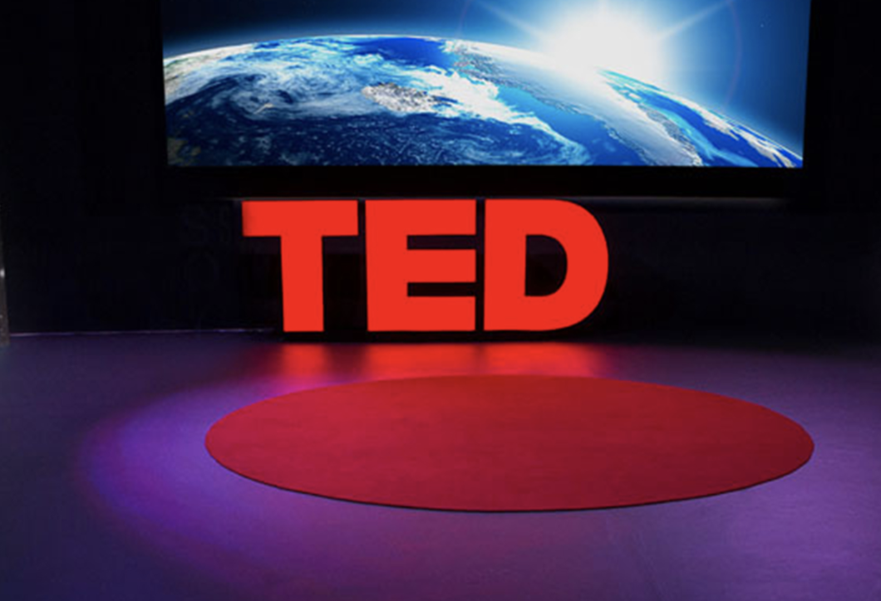
?

Slide 3
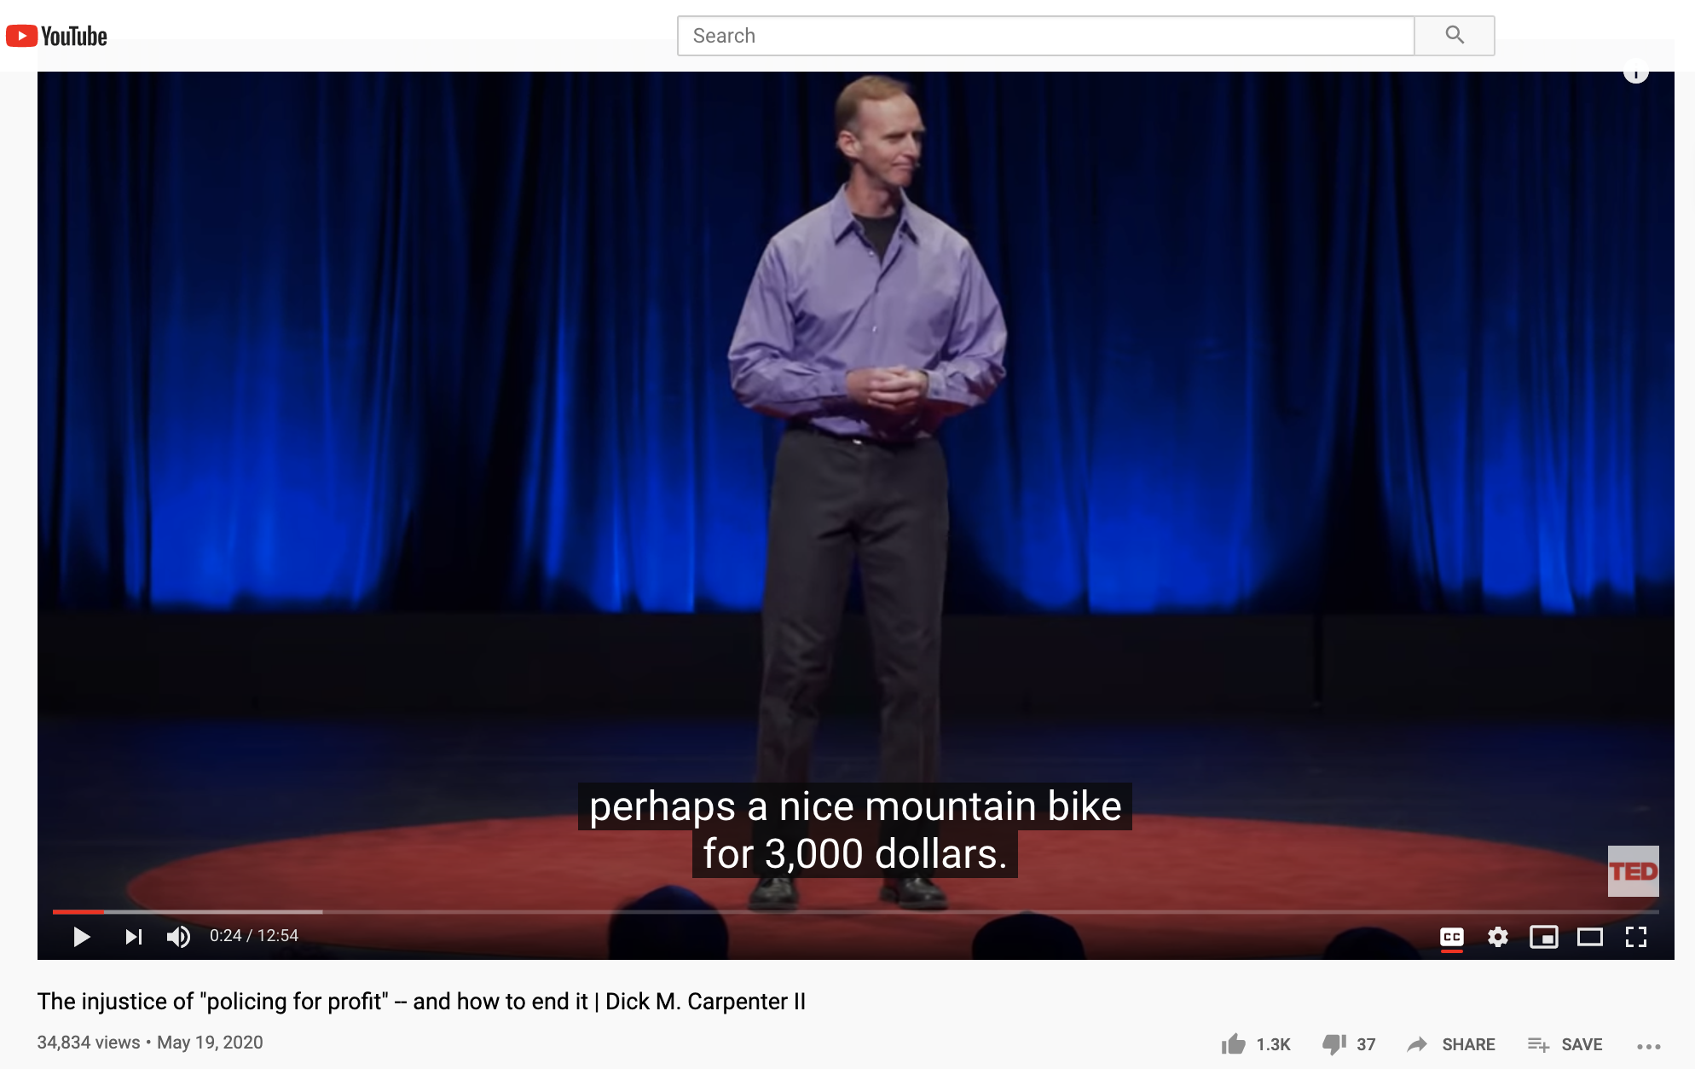
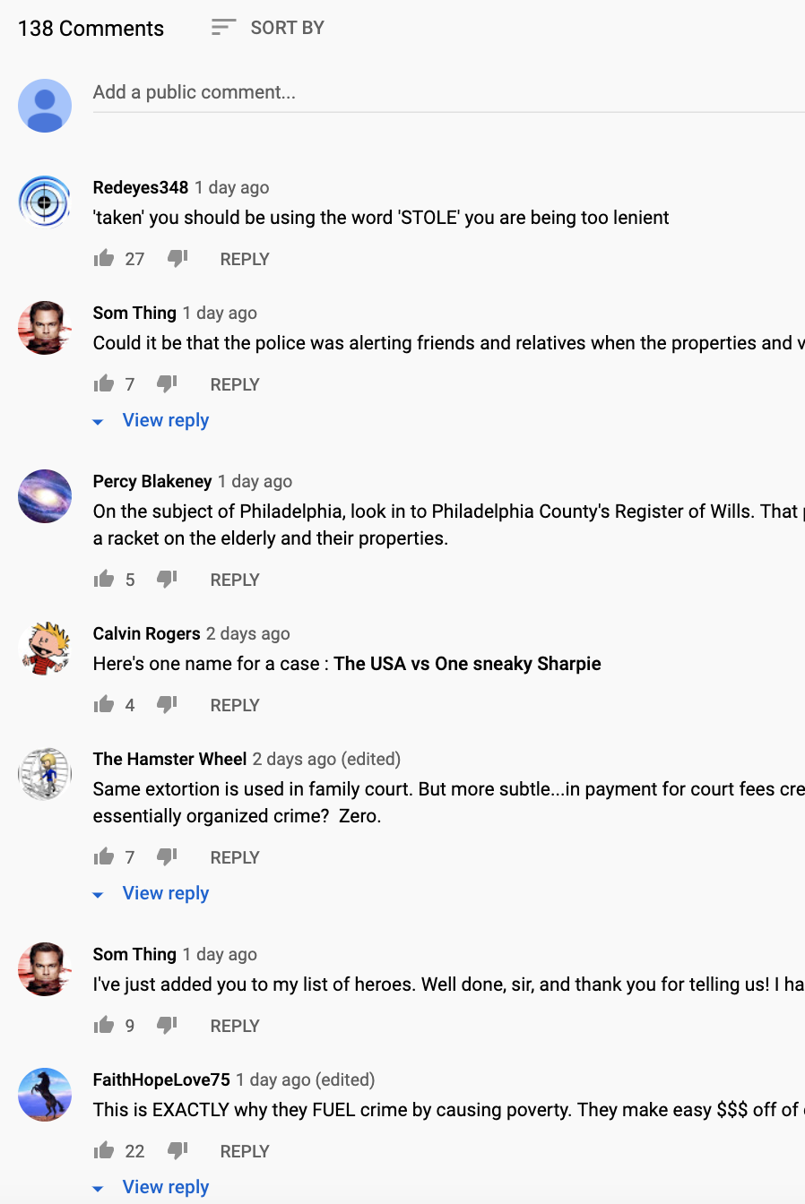

DATA COLLECTION
transcript
statistics
comments

Slide 4




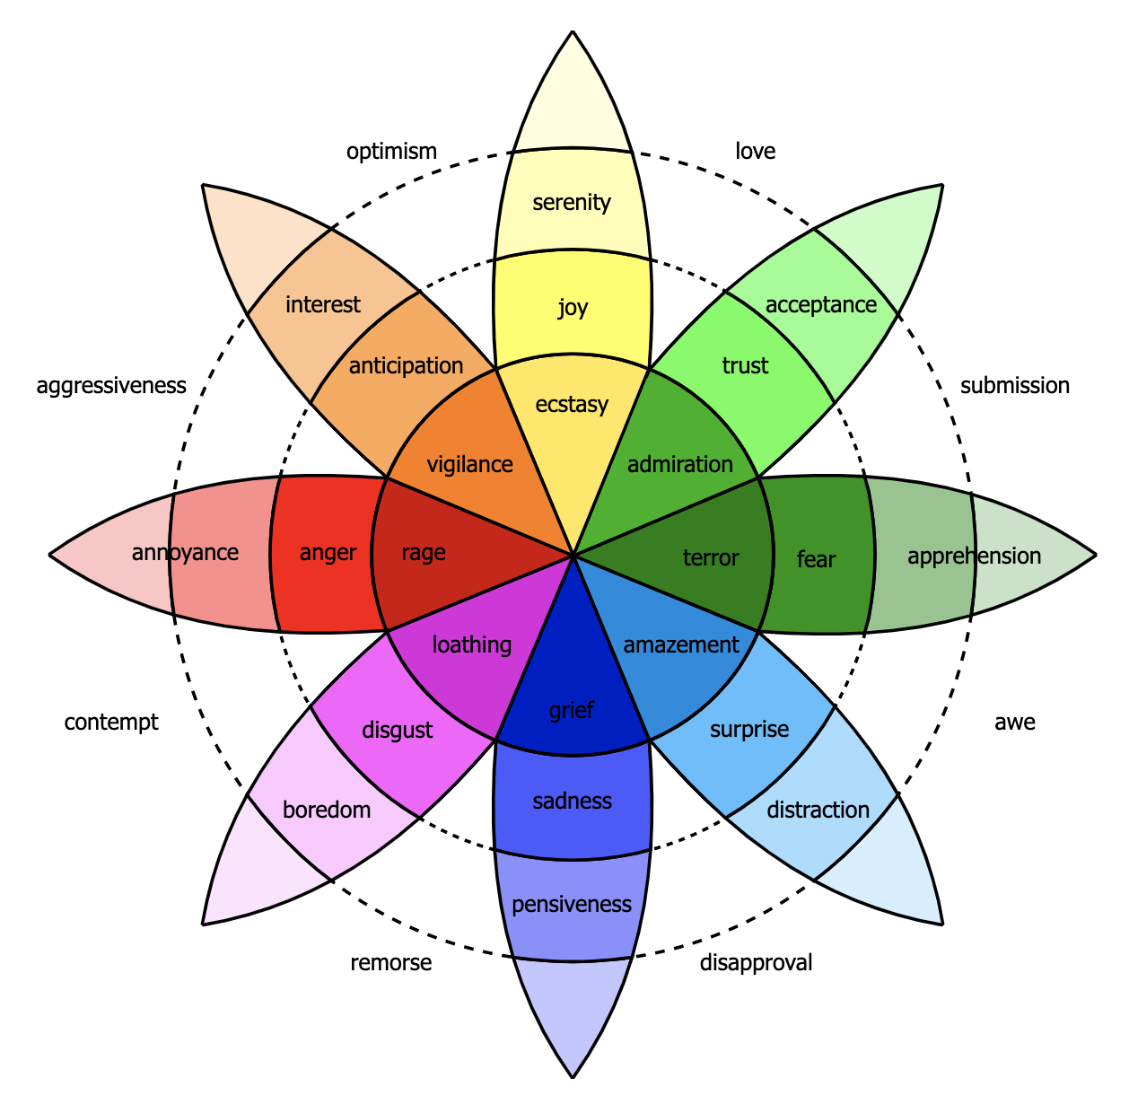
DATA COLLECTION
~ 2000 videos (2010 – 2020)
….preprocessing
….preprocessing
….preprocessing
Google API
Python YouTube Transcript API

Slide 5



TOPIC MODELING
TRANSCRIPT
SENTIMENT ANALYSIS
COMMENTS
RECOMMENDER SYSTEM
YOUR NEXT AWESOME TED TALK

Slide 6
TOPIC MODELING
5
7
10
13
15
LSA
NMF
LDA
COREX
TF-IDF
VECTORIZER

Slide 7
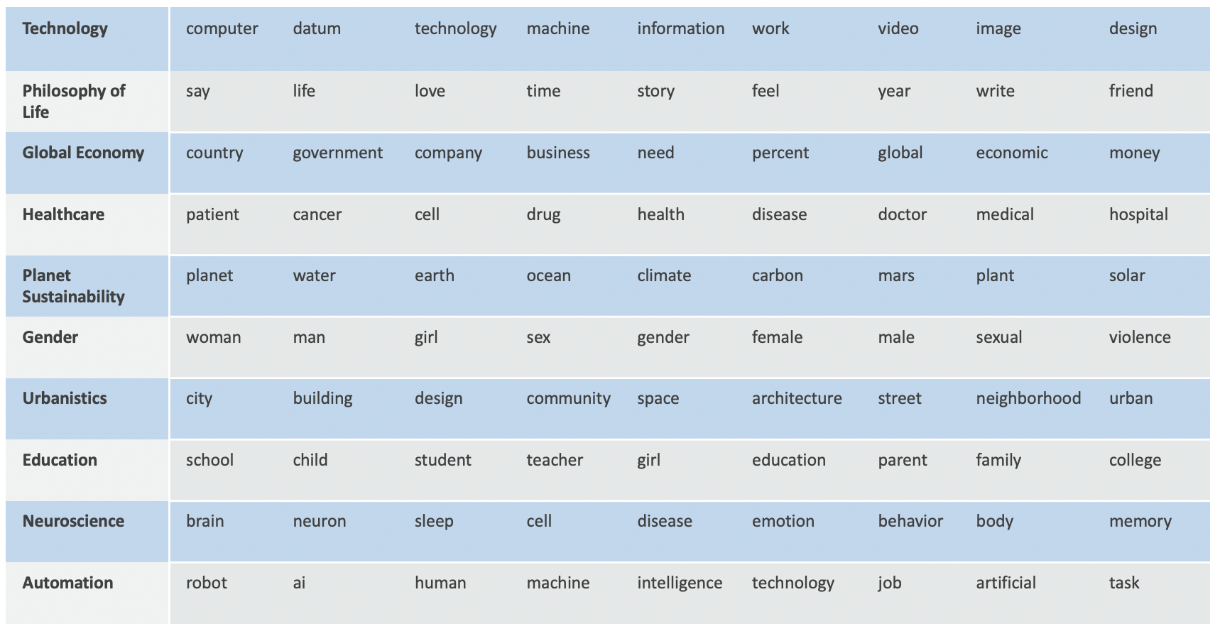
TOPIC MODELING

Slide 8
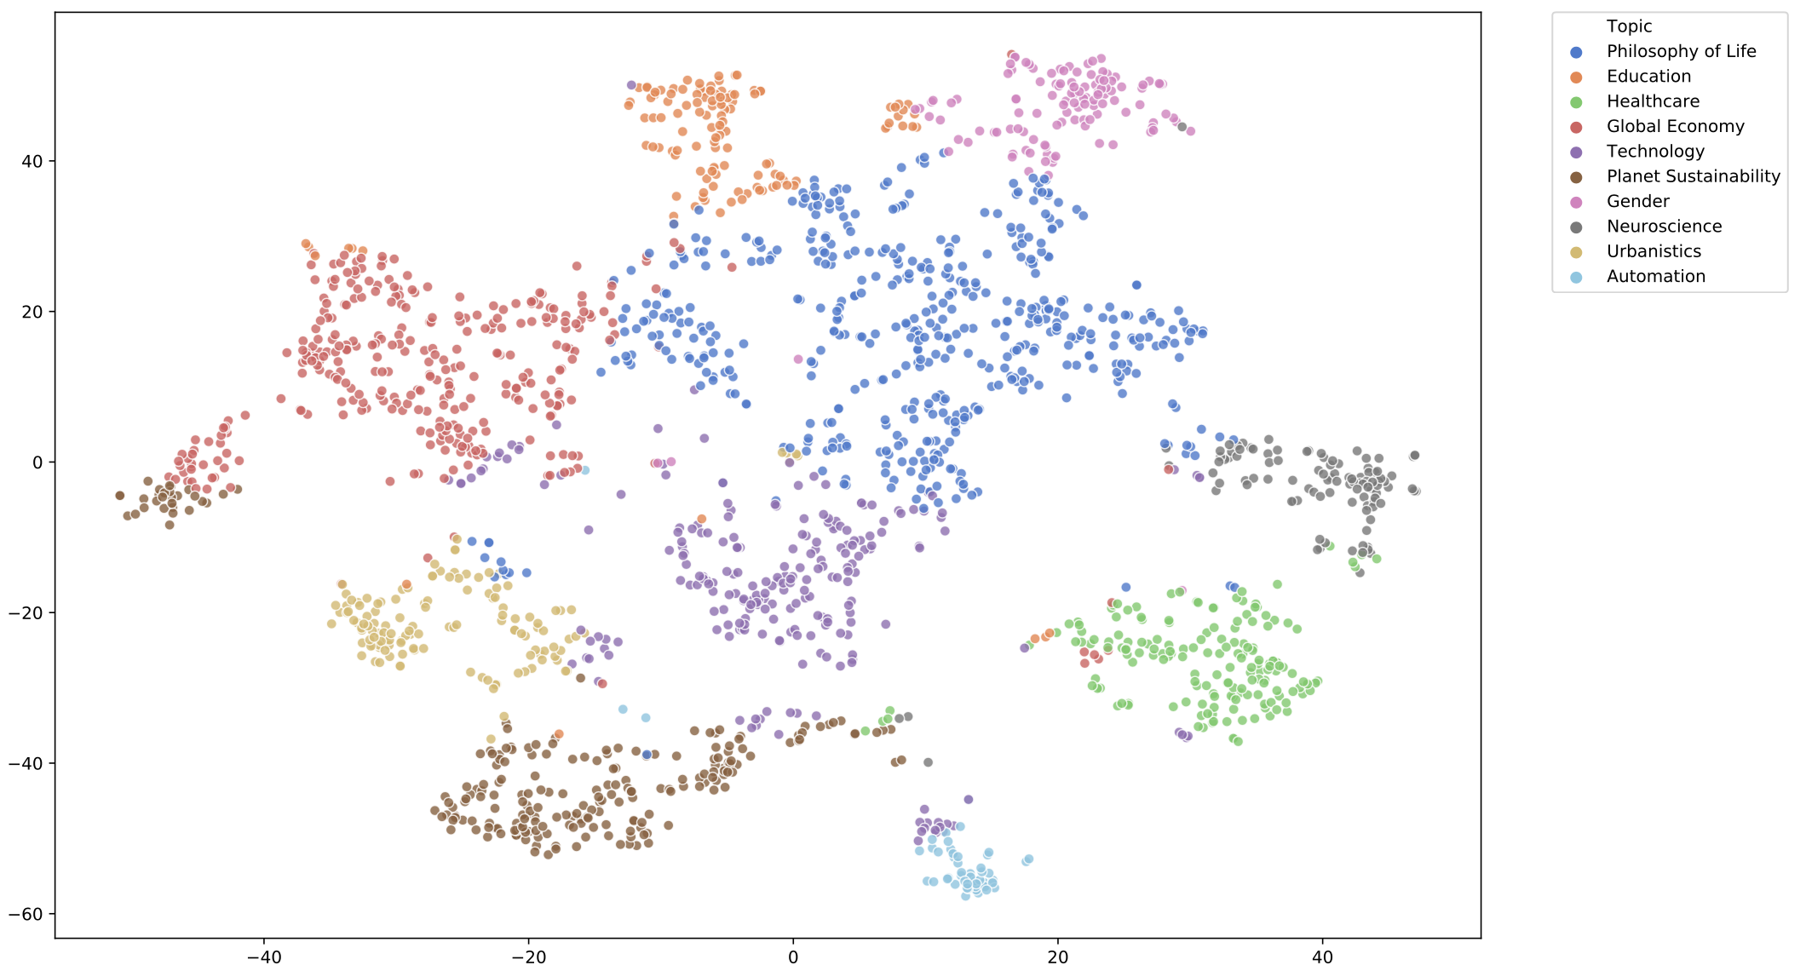

Slide 9
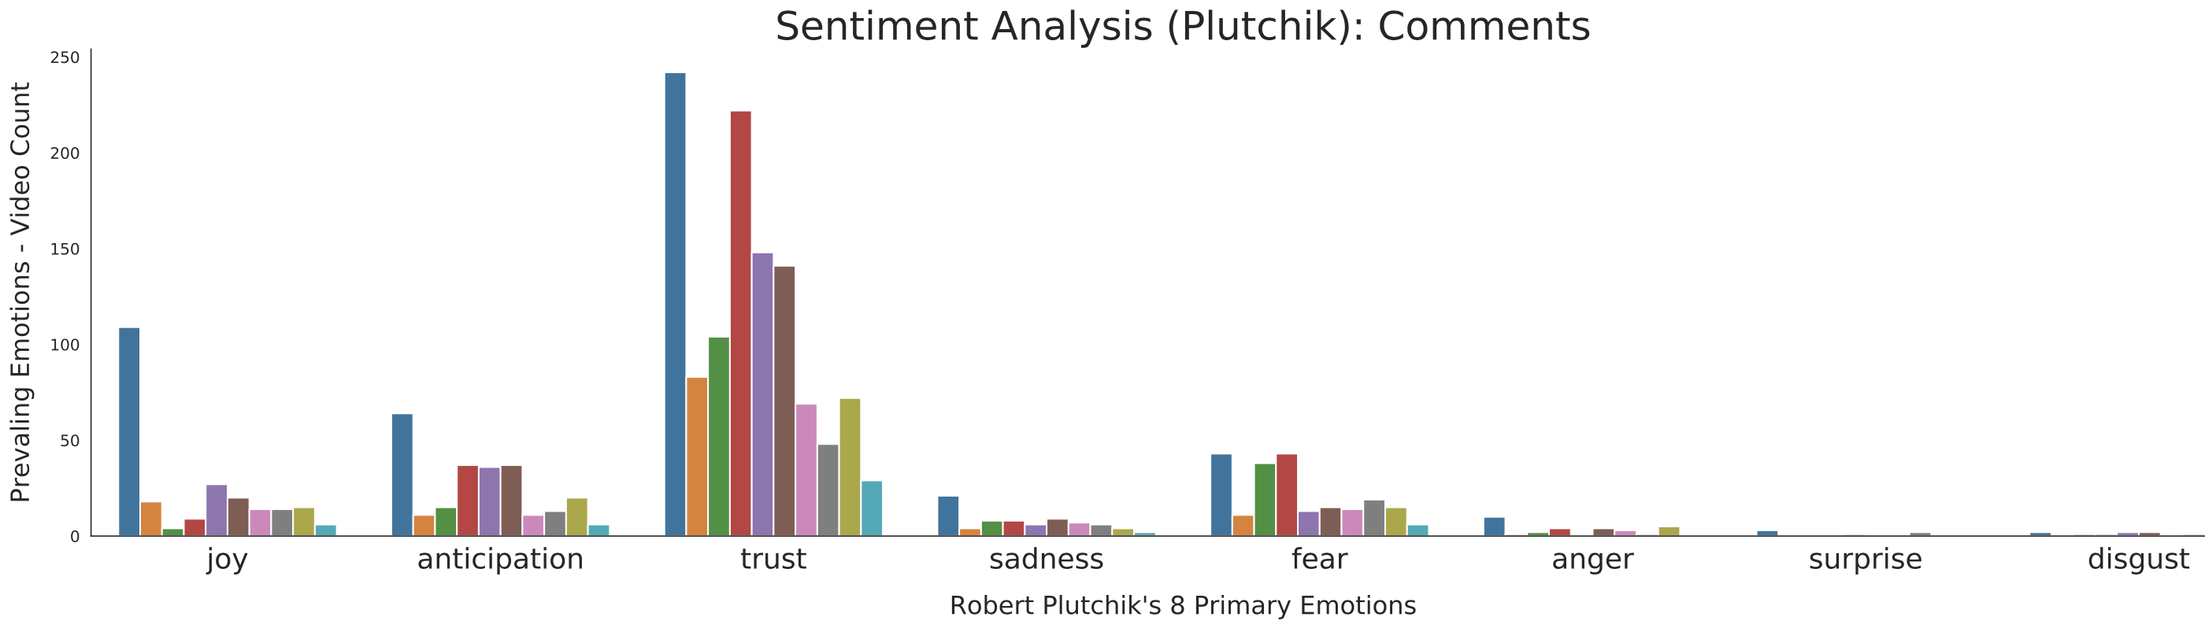
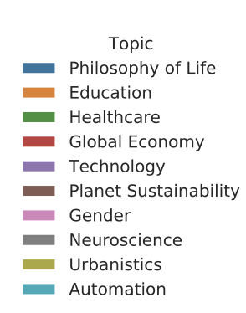
EMOTIONS

Slide 10

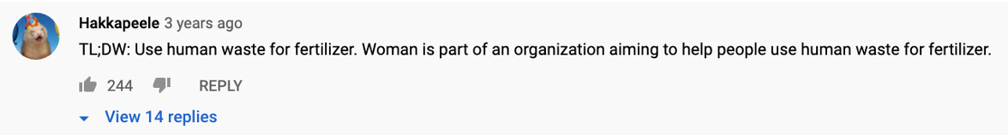
Digging In: Most “Disgusting” Ted Talk
The taboo secret to better health | Molly Winter

Slide 11
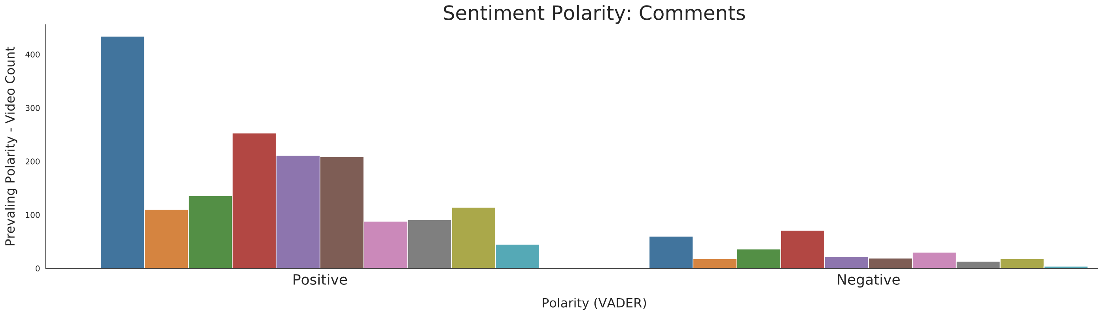
POLARITY
Appendix

Slide 12
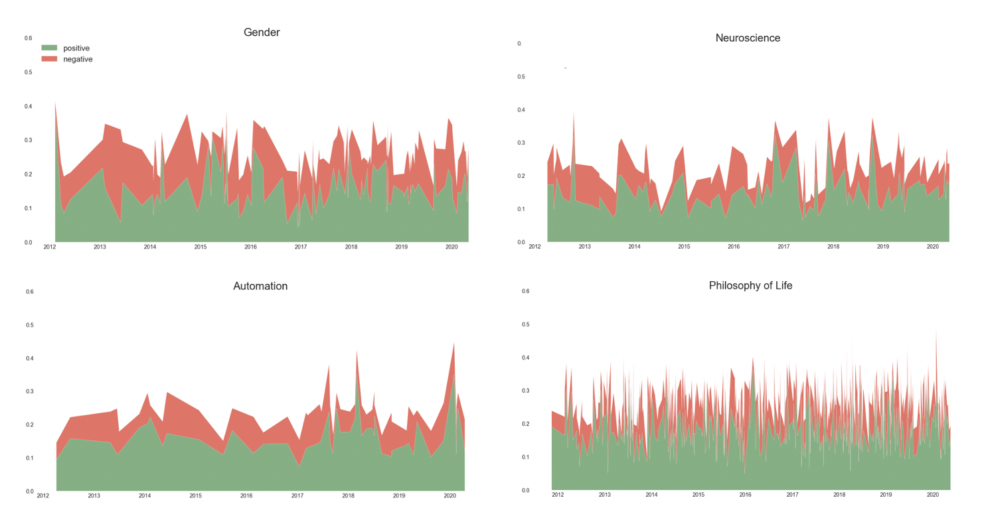

POLARITY TRENDS
Positive trend
Most Neutral
Recent Positive trend
Little Negativity

Slide 13
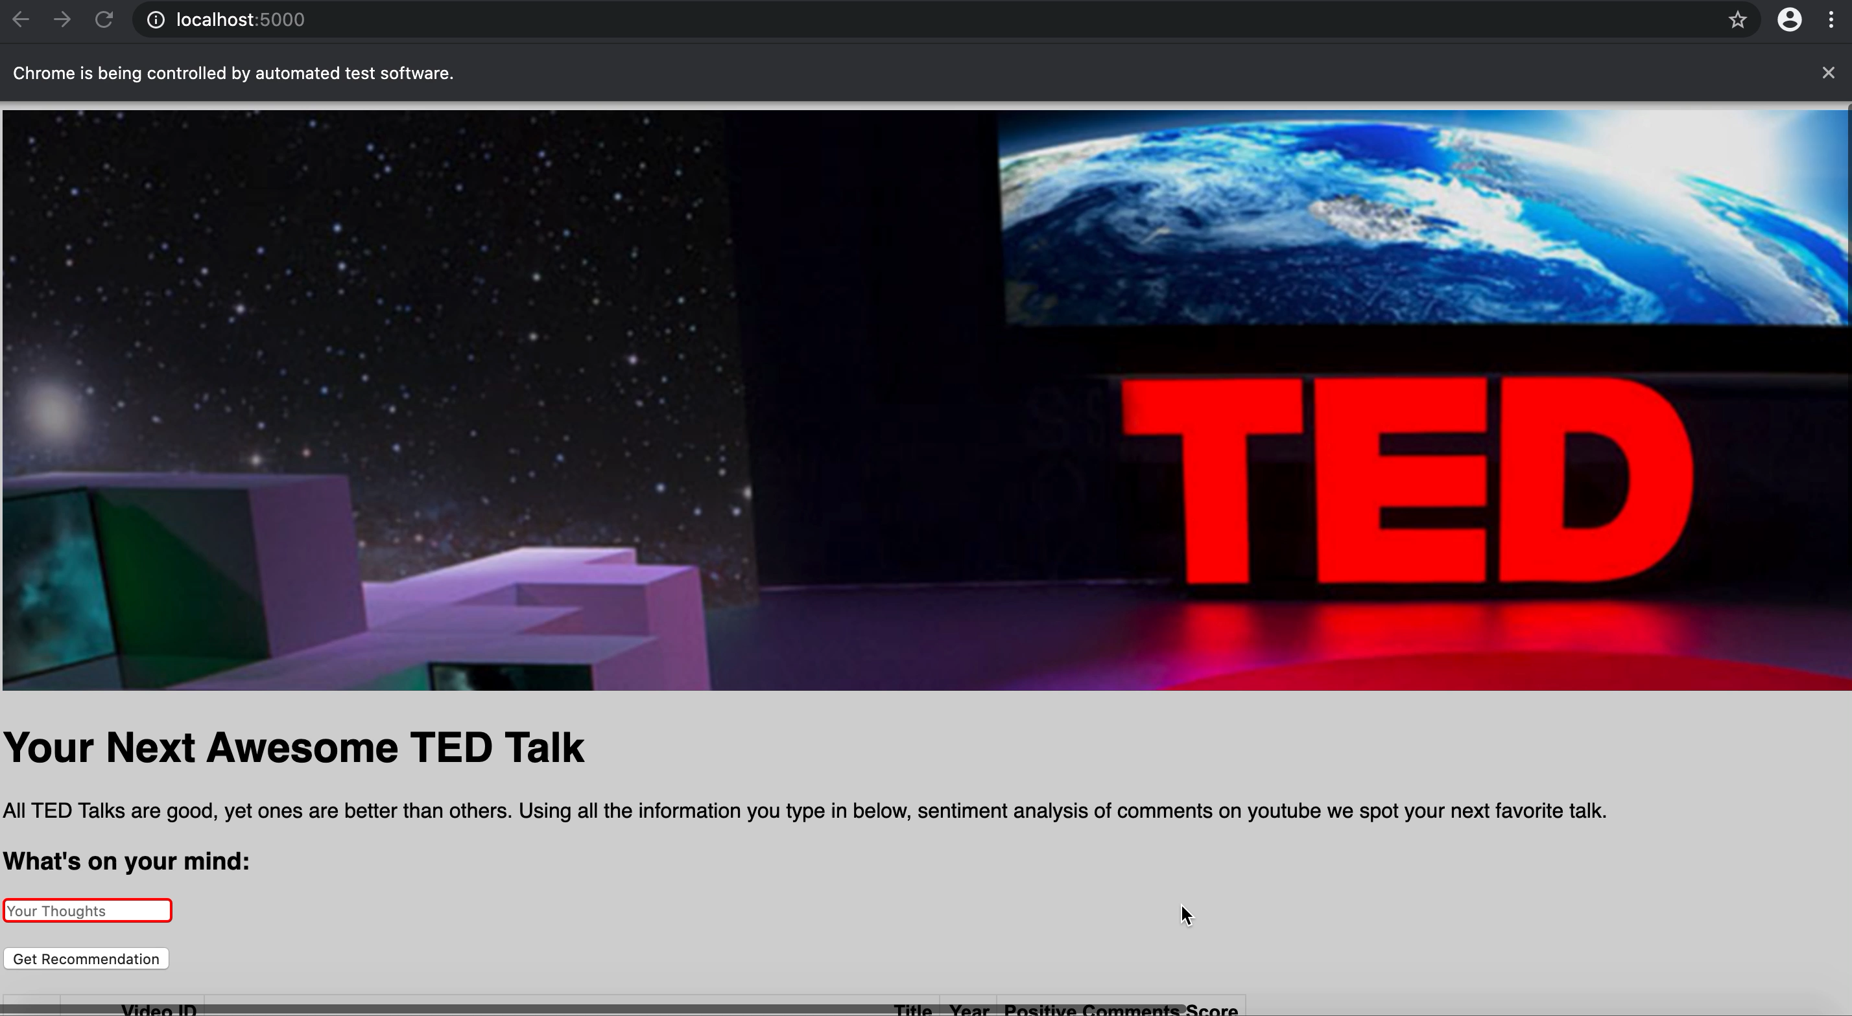

Slide 14
Appendix

Slide 15
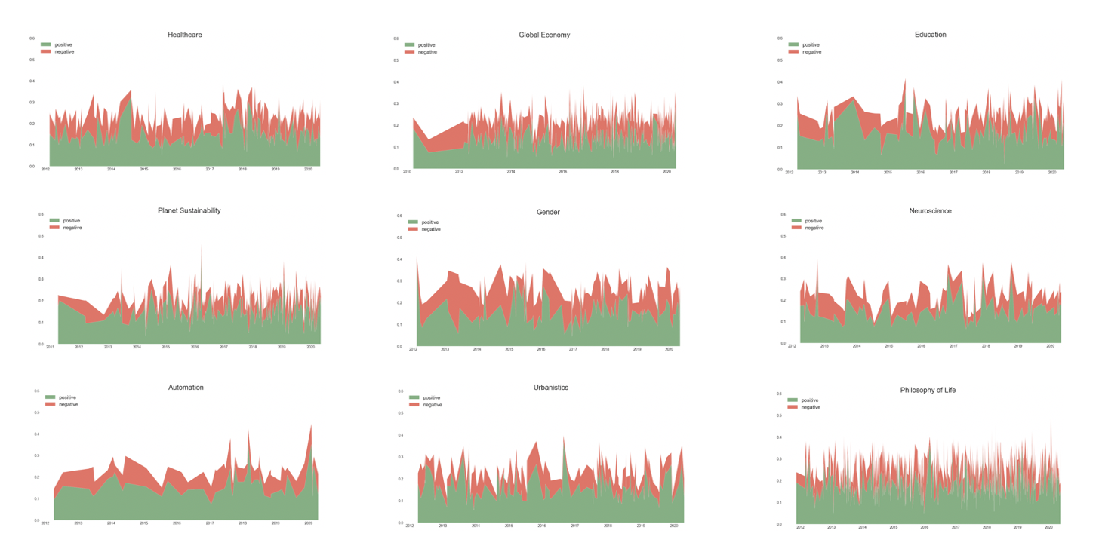
Polarity Trends: All Topics

Slide 16
Plutchik’s Emotions Covered
2nd circle

